Slide 1




HEART DISEASE PREDICTION USING MACHINE LEARNING
The Silent Killer: Innovations in Cardiovascular Disease Prevention

Slide 2

Problem Statement
To develop a machine learning classification model that can accurately predict the presence of heart disease using various medical parameters.
04

Slide 3
Intoduction
What is Heart Disease?
A range of conditions affecting the heart such as coronary artery disease, arrhythmias, and heart failure.
Role of Machine Learning
•- Analyzes patterns in historical data
•- Assists in diagnosing heart disease based on symptoms and tests
•- Improves prediction accuracy with large-scale data

Slide 4

Dataset Overview
•Dataset Used: UCI Heart Disease Dataset
•Key Features:
•- Age
•- Sex
•- Chest Pain Type
•- Resting Blood Pressure
•- Cholesterol
•- Fasting Blood Sugar
•- Max Heart Rate Achieved
•- Exercise-Induced Angina
•- ST Depression
•- Target (0: No Disease, 1: Disease)

Slide 5

Methodology
Step 1: Data Collection
Step 2: Data Preprocessing
Step 3: Exploratory Data Analysis (EDA)
• Visualize correlations using a heatmap
• Plot distributions for key variables
Step 4: Model Building
• Logistic Regression
Step 5: Model Evaluation
• Accuracy
• Confusion Matrix
• Classification Report
Step 6: Visualization
• Heatmaps
• ROC curves
• Confusion Matrix

Slide 6
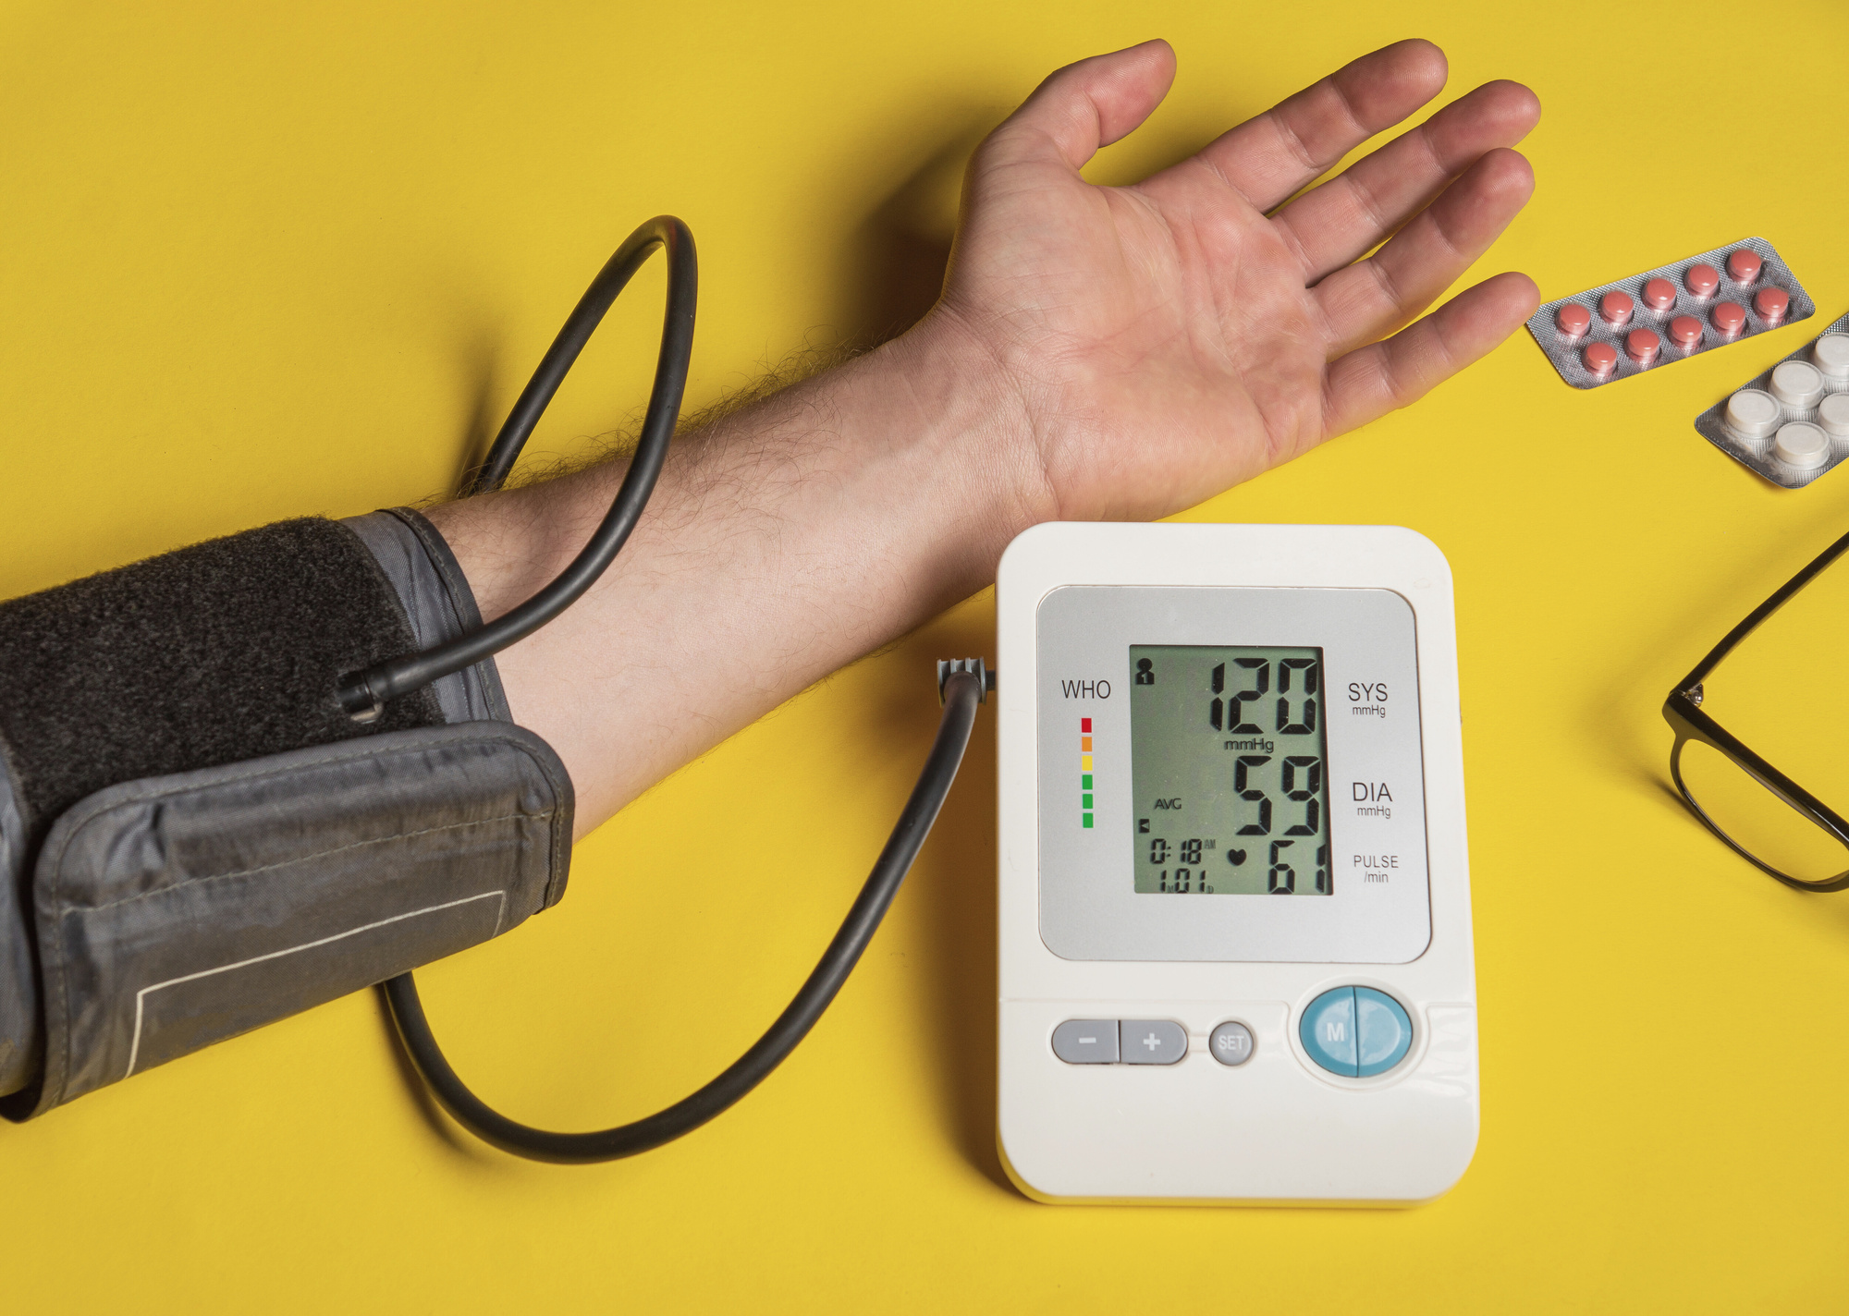


Data Visualization
Correlation Heatmap : To show relations between features
Receiver Operating Characteristic Curve
Classification Report
Confusion Matrix(regarding truth & prediction)

Slide 7
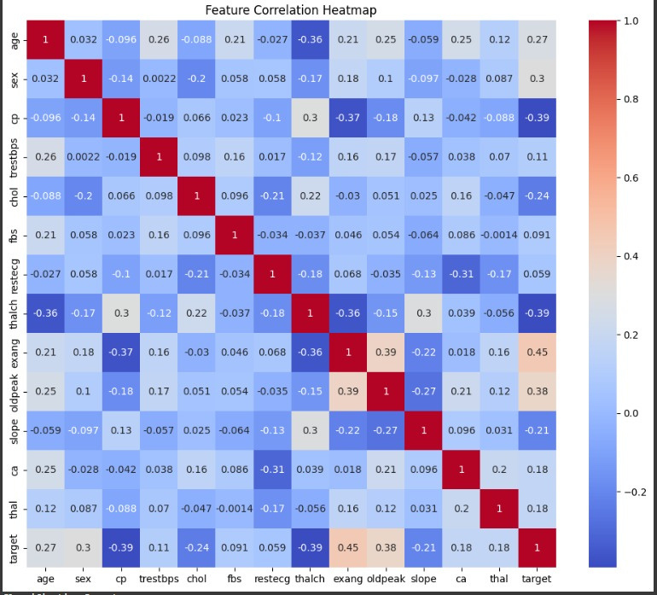
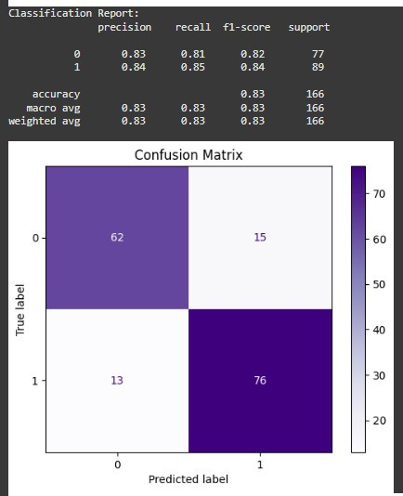
Output

Slide 8
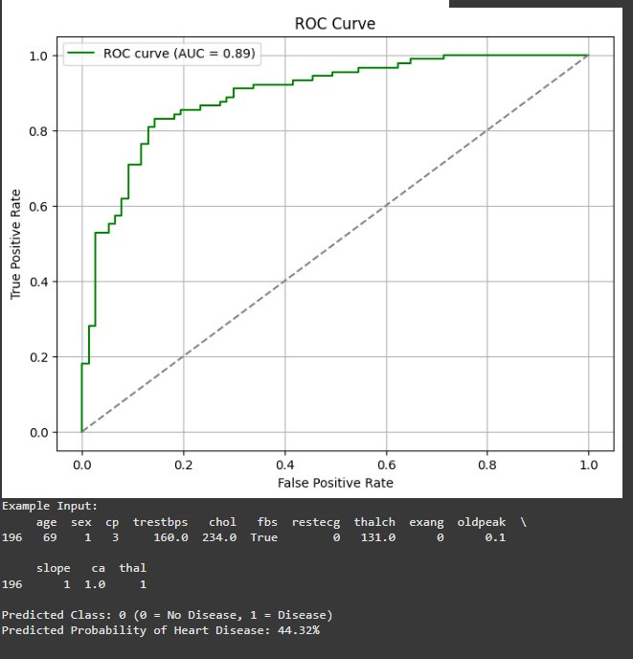

Slide 9

Future Work:
•- Use larger and more diverse datasets
•- Apply deep learning methods
•- Build a real-time diagnosis tool

Slide 10
Conclusion
•- A classification model was successfully developed and tested.
•- Random Forest gave the best performance.
•- Feature importance and ROC helped understand model behavior.

Slide 11
References
•- UCI Machine Learning Repository
•- Scikit-learn Documentation
•- Research papers and articles on heart disease prediction

Slide 12
THANK
YOU

